Slide 1
Chapter 2. Introducing the UML
Chapter 2
The Unified Modeling Language User Guide
SECOND EDITION
By Grady Booch, James Rumbaugh, Ivar Jacobson

Slide 2
What is UML?
Unified Modeling Language
OMG Standard, Object Management Group Based on work from Booch, Rumbaugh, Jacobson
UML is a modeling language to express and design documents, software:
Particularly useful for OO design
Not a process
Independent of implementation language

Slide 3
Why use UML
Standardized graphical notation for
Specifying
Visualizing
Constructing and
Documenting software systems
Language can be used from general initial design to very specific detailed design
Increase understanding/communication of product to customers and developers
Support for UML in many software packages today (e.g. Rational)

Slide 4
The UML is a language for Visualizing
Some things are best modeled textually; others graphically
The UML is more than just a bunch of graphical symbols
One developer can write a model in the UML, and another developer, or even another tool, can interpret that model unambiguously

Slide 5
The UML is a language for Specifying
Specifying means building models that are precise, unambiguous, and complete
In particular, the UML addresses the specification of all the important analysis, design, and implementation decisions that must be made in developing and deploying a software-intensive system.

Slide 6
The UML is a language for Constructing
UML is not a visual programming language, but its models can be directly connected to a variety of programming languages
It is possible to map from a model in the UML to a programming language such as Java, C++, or VB, or even to tables in a RDBMS

Slide 7
The UML is a language for Documenting
The UML addresses the documentation of a system’s architecture and all of its details
The UML also provides a language for expressing requirements and for tests
Finally, the UML provides a language for modeling the activities of project planning and release management

Slide 8
Building blocks of the UML
The vocabulary of the UML encompasses three kinds of building blocks:
Things - abstractions that are first-class citizens in a model
Relationships - tie these things together
Diagrams - group interesting collections of things

Slide 9
Things in the UML
Structural things
Behavioral things
Grouping things
Annotation things

Slide 10
Structural things
Structural things are the nouns of the UML model. These are the mostly static parts of a model, representing elements that are either conceptual or physical. There are seven kinds of structural things.

Slide 11

Structural things
A class is a description of set of objects that share the same attributes, operations, relationships, and semantics.

Slide 12
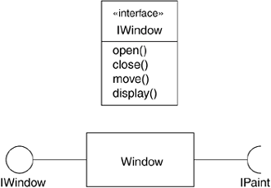
Structural things
An interface is a collection of operations that specify a service of a class or component. An interface therefore describes the externally visible behavior of that element

Slide 13
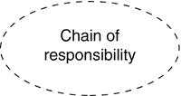
Structural things
A collaboration defines an interaction and is a society of roles and other elements that work together to provide some cooperative behavior that’s bigger than the sum of all the elements

Slide 14
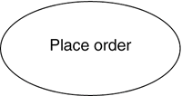
Structural things
A Use case is a description of set of sequence of actions that a system performs that yields an observable result of value to a particular actor.

Slide 15
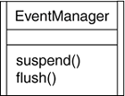
Structural things
An active class is a class whose objects own one or more processes or threads and therefore can initiate control activity. An active class is just like a class except that its objects represent elements whose behavior is concurrent with other elements.

Slide 16

Structural things
A component is a physical and replaceable part of a system that conforms to and provides the realization of a set of interfaces.

Slide 17

Structural things
An artifact is a physical and replaceable part of a system that contains physical information ("bits").

Slide 18
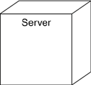
Structural things
A node is a physical element that exists at run time and represents a computational resource, generally having at least some memory and often, processing capability.

Slide 19
Behavioral Things
Behavioral things are the dynamic parts of UML models. These are the verbs of a model, representing behavior over time and space. There are two kinds of behavioral things

Slide 20
Behavioral Things
An interaction is a behavior that comprises a set of messages exchanged among a set of objects within a particular context to accomplish a specific purpose.

Slide 21

Behavioral Things
A state machine is a behavior that specifies the sequences of states an object or an interaction goes through during its lifetime in response to events.

Slide 22

Behavioral Things
An activity is a behavior that specifies the sequence of steps a computational process performs. In an interaction, the focus is on the set of objects that interact.
In a state machine, the focus is on the life cycle of one object at a time. In an activity, the focus is on the flows among steps without regard to which object performs each step.
A step of an activity is called an action.

Slide 23
Grouping Things
Grouping things are the organizational parts of UML models. These are the boxes into which a model can be decomposed. There is one primary kind of grouping thing, namely, packages.
There are also variations, such as frameworks, models, and subsystems (kinds of packages).

Slide 24
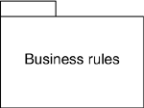
Grouping Things
A package is a general-purpose mechanism for organizing elements into groups. Structural things, behavioral things, and even other grouping things can be placed in a package. Unlike components (which exists at runtime), a package is purely conceptual (meaning that it only exists at development time).

Slide 25

Annotational Things
Annotational things are the explanatory parts of UML models. These are the comments you may apply to describe, illuminate, and remark about any element in a model.
There is one primary kind of annotational thing, called a note. A note is simply a symbol for rendering constraints and comments attached to an element or a collection of elements.

Slide 26
Relationships in the UML
There are four kinds of relationships in the UML:
Dependency
Association
Generalization
Realization

Slide 27
Relationships in the UML
A dependency is a semantic relationship between two things in which a change to one (the independent thing) may effect the semantics of the other thing (the dependent thing).

Slide 28

Relationships in the UML
An Association is a structural relationship that describes a set of links. A link is a connection among objects.

Slide 29
Relationships in the UML
A generalization is a specialization/ generalization relationship in which objects of the specialized element (the child) and substitutable for objects of the generalized element (the parent). In this way, the child shares the structure and behavior of the parent.

Slide 30
Relationships in the UML
A realization is a semantic relationship between classifiers, wherein one classifier specifies a contract that another classifier guarantees to carry out.

Slide 31
Diagrams in the UML
A diagram is the graphical presentation of a set of elements, most often rendered as a connected graph of vertices (things) and arcs (relationships). The UML includes nine such diagrams.

Slide 32
Diagrams in the UML
Class diagram
Object diagram
Component diagram
Composite structure diagram
Use case diagram
Sequence diagram
Communication diagram
State diagram
Activity diagram
Deployment diagram
Package diagram
Timing diagram
Interaction overview diagram

Slide 33
Diagrams in the UML
A Class diagram shows a set of classes, interfaces, and collaborations and their relationships. Class diagrams address the static design view of a system. Class diagram that includes active classes address the static process view of a system.
An object diagram shows a set of objects and their relationships. Object diagrams represent static snapshots on instances of the things found in class diagrams. These designs address the static design or process view of a system from the perspective of real or prototypical cases.

Slide 34
Diagrams in the UML
A component diagram shows an encapsulated class and its interfaces, ports, and internal structure consisting of nested components and connectors. Component diagrams address the static design implementation view of a system.

Slide 35
Diagrams in the UML
A Use case diagram shows a set of use cases and actors and their relationships. Use case diagrams address the static use case view of a system.

Slide 36
Diagrams in the UML
Both sequence diagrams and communication diagrams are kinds of interaction diagrams.
An interaction diagram shows an interaction, consisting of a set of objects or roles, including the messages that may be dispatched among them.
Interaction diagrams address the dynamic view of a system.
A sequence diagram is an interaction diagram that emphasizes the time-ordering of messages; a communication diagram is an interaction diagram that emphasizes the structural organization of the objects or roles that send and receive messages.
Sequence diagrams emphasize temporal ordering, and communication diagrams emphasize the data structure through which messages flow.

Slide 37
Diagrams in the UML
A state diagram shows a state machine, consisting of states, transitions, events, and activities. A state diagrams shows the dynamic view of an object.
An activity diagram shows the structure of a process or other computation as the flow of control and data from step to step within the computation. Activity diagrams address the dynamic view of a system. They are especially important in modeling the function of a system and emphasize the flow of control among objects.

Slide 38
Diagrams in the UML
A deployment diagram shows the configuration of run-time processing nodes and the components that live on them. Deployment diagrams address the static deployment view of an architecture. A node typically hosts one or more artifacts.
An artifact diagram shows the physical constituents of a system on the computer. Artifacts include files, databases, and similar physical collections of bits. Artifacts are often used in conjunction with deployment diagrams. Artifacts

Slide 39
Diagrams in the UML
A package diagram shows the decomposition of the model itself into organization units and their dependencies.
A timing diagram is an interaction diagram that shows actual times across different objects or roles, as opposed to just relative sequences of messages.
An interaction overview diagram is a hybrid of an activity diagram and a sequence diagram.

Slide 40
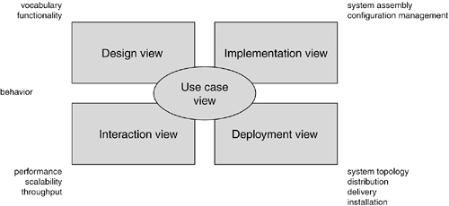
Modeling a System's Architecture

Slide 41
The UML Architecture
Visualizing, specifying, constructing and documenting a software intensive system demands that the system be viewed from a number of perspectives.
Different stakeholders- end users, analysts, developers, system integrators, testers, technical writers and project managers- each bring different agenda to a project, and each looks at that system in different ways at different times over the project’s life.

Slide 42
The UML Architecture
The use case view of a system encompasses the use cases that describe the behavior of the system as seen by its end users, analysts, and testers. With the UML, the static aspects of this view are captured in use case diagrams; the dynamic aspects of this view are captured in interaction diagrams, state diagrams, and activity diagrams.
The design view of a system encompasses the classes, interfaces, and collaborations that form the vocabulary of the problem and its solution. This view primarily supports the functional requirements of the system, meaning the services that the system should provide to its end users. With the UML, the static aspects of this view are captured in class diagrams and object diagrams; the dynamic aspects of this view are captured in interaction diagrams, state diagrams, and activity diagrams.

Slide 43
The UML Architecture
The interaction view of a system shows the flow of control among its various parts, including possible concurrency and synchronization mechanisms. This view primarily addresses the performance, scalability, and throughput of the system. With the UML, the static and dynamic aspects of this view are captured in the same kinds of diagrams as for the design view, but with a focus on the active classes that control the system and the messages that flow between them.
The implementation view of a system encompasses the artifacts that are used to assemble and release the physical system. This view primarily addresses the configuration management of the system's releases, made up of somewhat independent files that can be assembled in various ways to produce a running system. It is also concerned with the mapping from logical classes and components to physical artifacts. With the UML, the static aspects of this view are captured in artifact diagrams; the dynamic aspects of this view are captured in interaction diagrams, state diagrams, and activity diagrams.

Slide 44
The UML Architecture
The deployment view of a system encompasses the nodes that form the system's hardware topology on which the system executes. This view primarily addresses the distribution, delivery, and installation of the parts that make up the physical system. With the UML, the static aspects of this view are captured in deployment diagrams; the dynamic aspects of this view are captured in interaction diagrams, state diagrams, and activity diagrams.

Slide 45
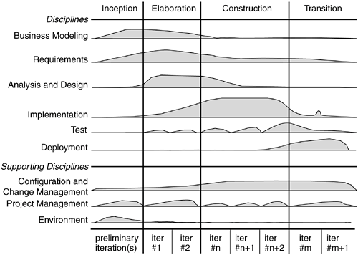
Software Development Life Cycle

Slide 46
Software Development Life Cycle
Inception is the first phase of the process, when the seed idea for the development is brought up to the point of being at least internally sufficiently well-founded to warrant entering into the elaboration phase.
Elaboration is the second phase of the process, when the product requirements and architecture are defined. In this phase, the requirements are articulated, prioritized, and baselined. A system's requirements may range from general vision statements to precise evaluation criteria, each specifying particular functional or nonfunctional behavior and each providing a basis for testing.
Construction is the third phase of the process, when the software is brought from an executable architectural baseline to being ready to be transitioned to the user community. Here also, the system's requirements and especially its evaluation criteria are constantly reexamined against the business needs of the project, and resources are allocated as appropriate to actively attack risks to the project.
Transition is the fourth phase of the process, when the software is delivered to the user community. Rarely does the software development process end here, for even during this phase, the system is continuously improved, bugs are eradicated, and features that didn't make an earlier release are added.
An iteration is a distinct set of work tasks, with a baselined plan and evaluation criteria that results in an executable system that can be run, tested, and evaluated.

